Slide 1
Operating Systems
& Command Line Basics

Slide 2
INTRODUCTION

Slide 3
CLASS OUTLINE
Warmup & Repetition
Operating Systems (OS) Basics
Principle of Abstraction
Graphical User Interfaces vs Command Line Interfaces
Linux File System Hierarchy
Linux Command Line Basics
Job Opportunities

Slide 4
Repetition

Slide 5
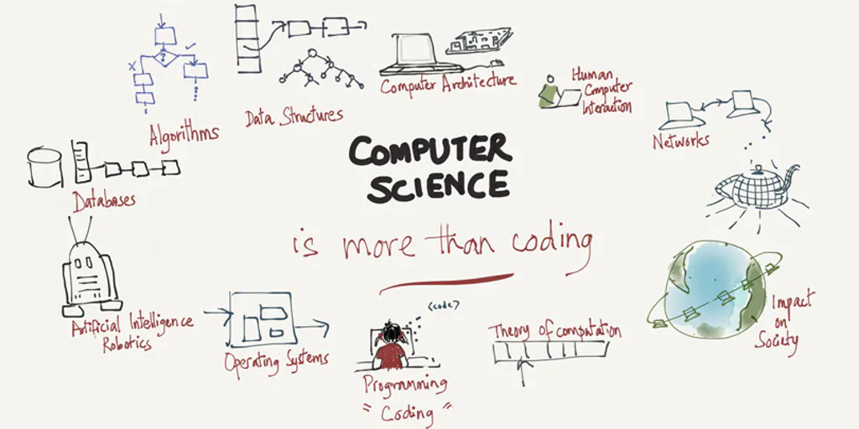
What is computer science
The science of information-processing with computers

Slide 6
Quiz
Question 1: How many videos are in the sequence?
Answer: 6
Question 2: What's the name of the guy starting the first video?
Answer: Bill Gates
Question 3: Do you know, which system this guy has developed and sold to IBM?
Answer: MS DOS
Question 4: What does "MS DOS" means?
Answer: Microsoft Disk Operating System
Question 5: What are the four main tasks a computer does, mentioned in the videos?
How Computers Work YouTube series
Answer: Input, Store, Process, Output

Slide 7
OPERATING SYSTEM (OS) BASICS

Slide 8



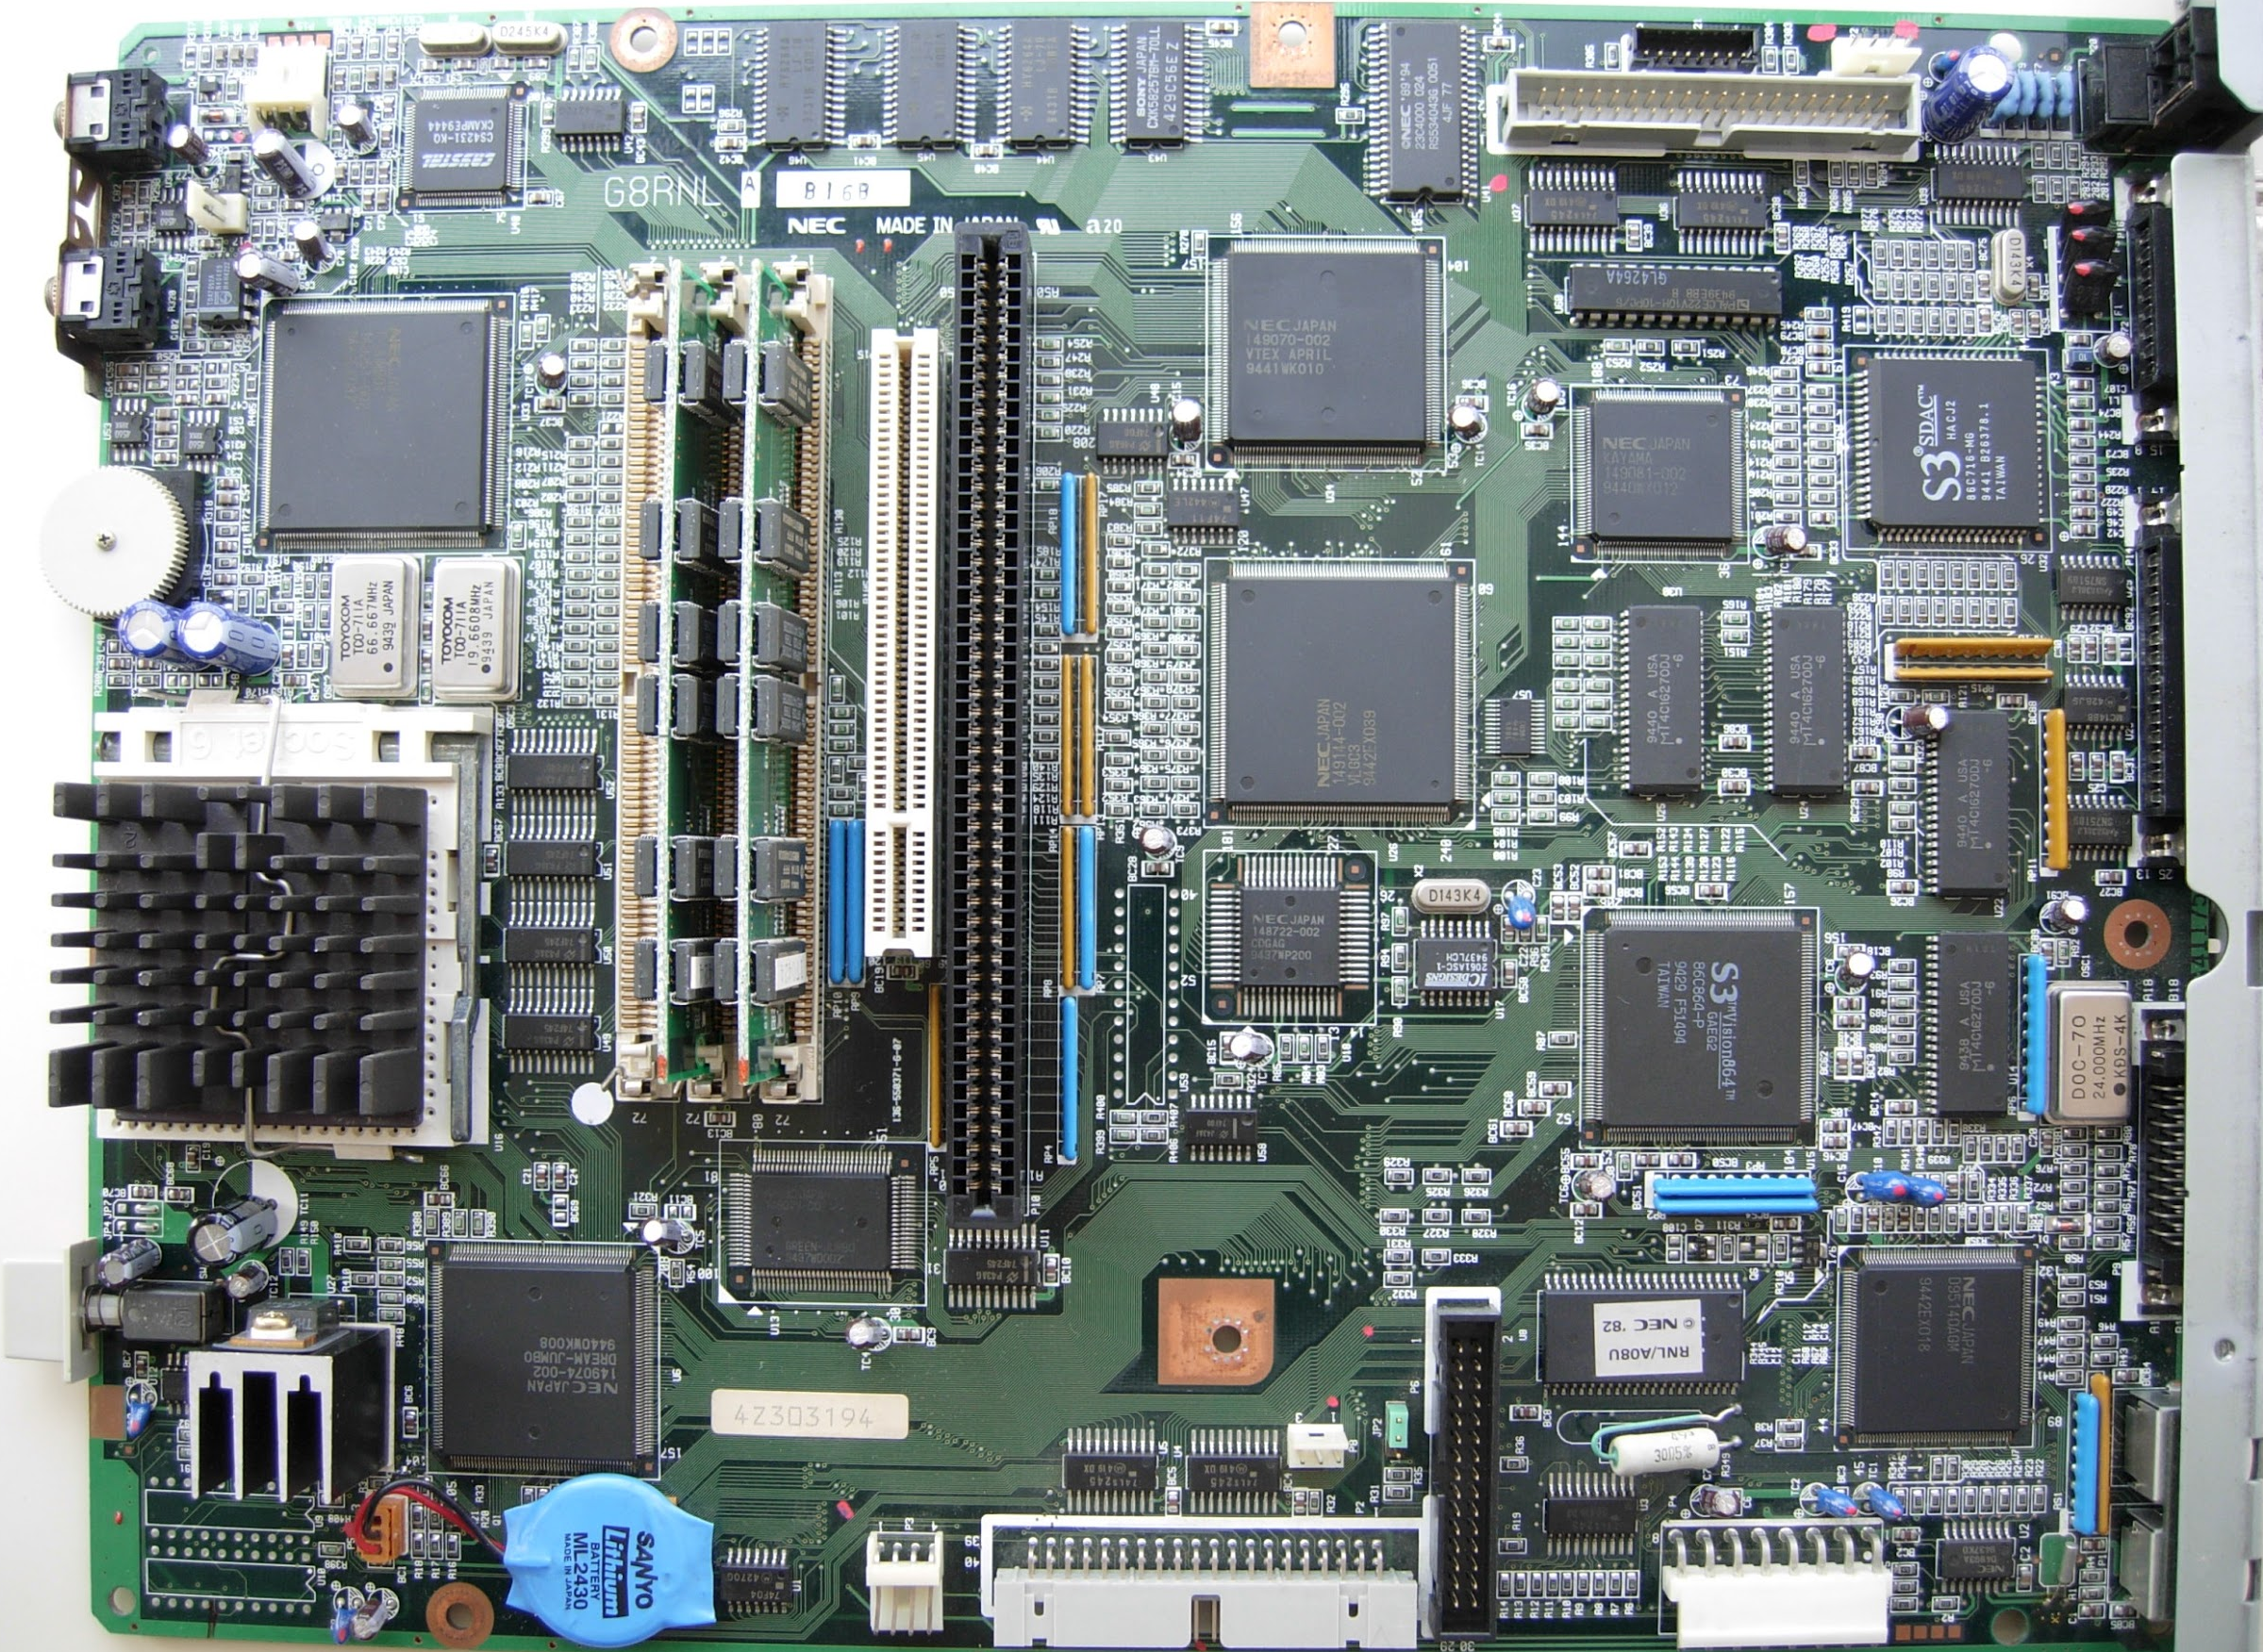



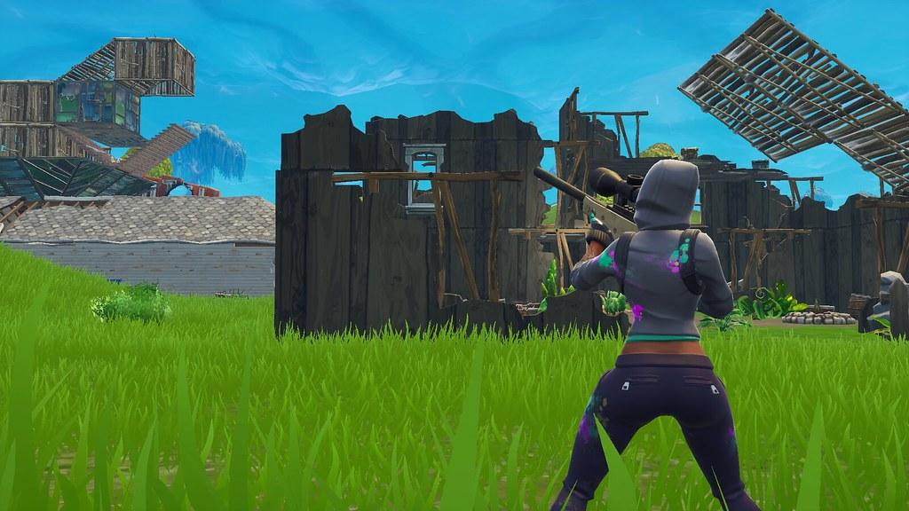
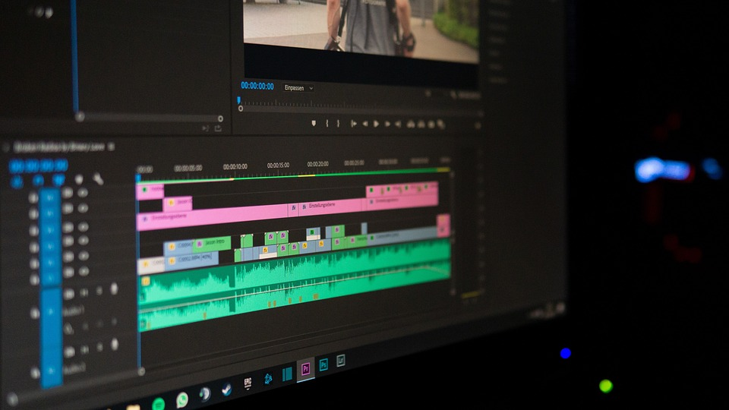
Operating System

Slide 9
What operating systems do you know?

Slide 10




Slide 11
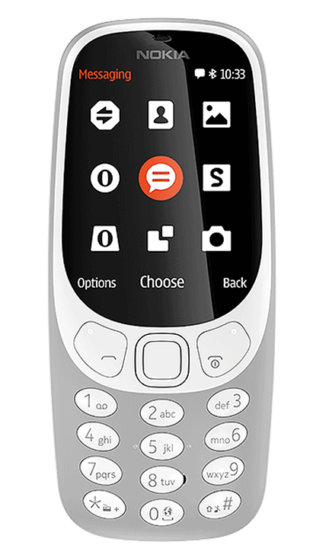



Slide 12
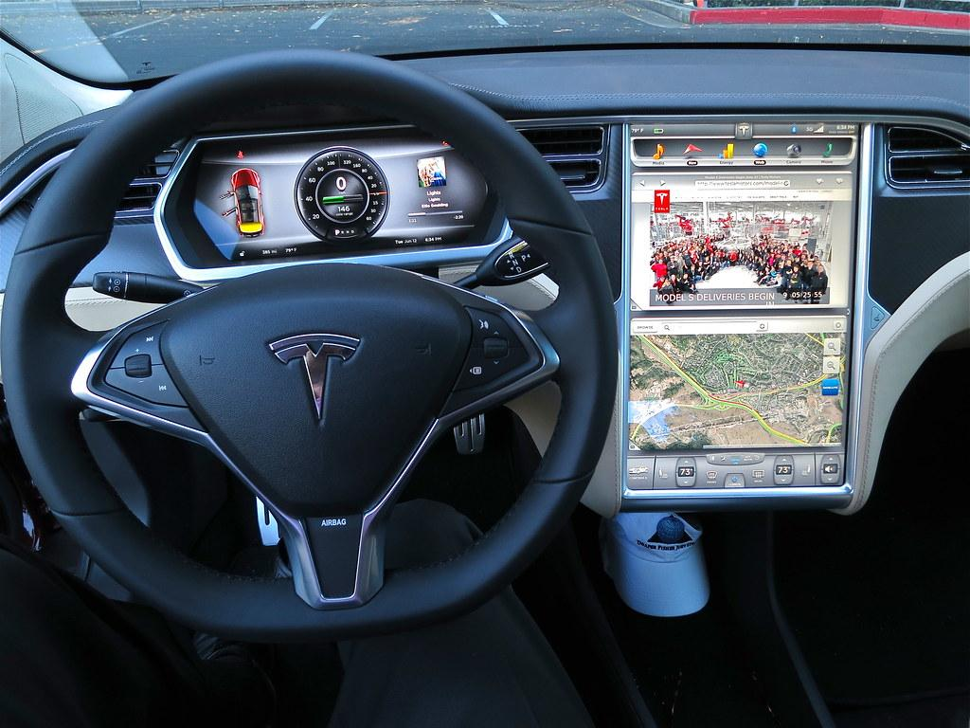
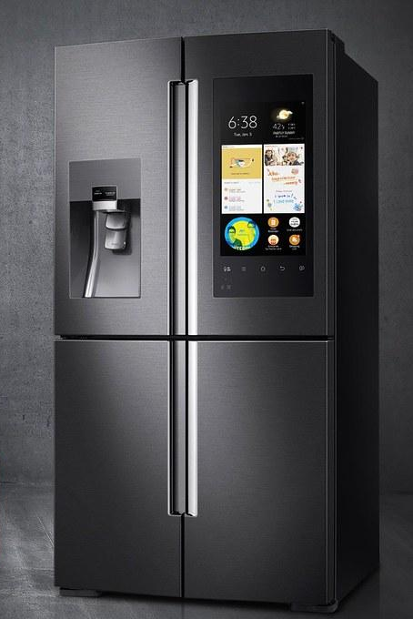
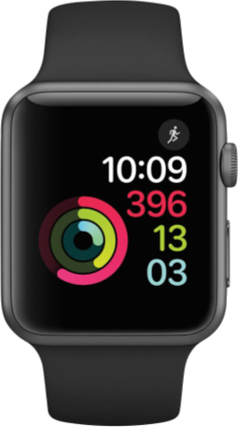

Slide 13

Operating systems
are like onions!

Slide 14

...or matryoshka
dolls

Slide 15

Hardware: hard-drive, RAM, processor/CPU, keyboard, mouse, sound card, etc.
Kernel: input-output, the "brain" of the big calculator
Shell: the interface to manipulate the OS
User applications: other programs can be useful

Slide 16
KERNEL ARCHITECTURE

Slide 17
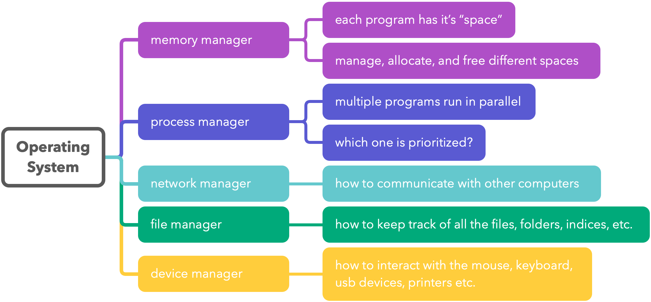

Slide 18
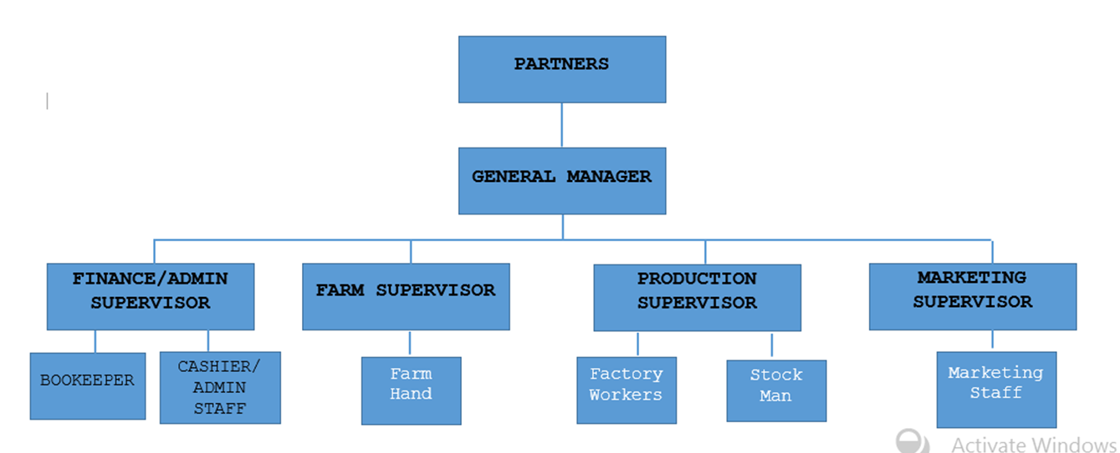
Just like in a company, the various kernel managers are expected to do their job and occasionally report results in a board meeting

Slide 19
PRINCIPLE OF ABSTRACTION

Slide 20


Slide 21
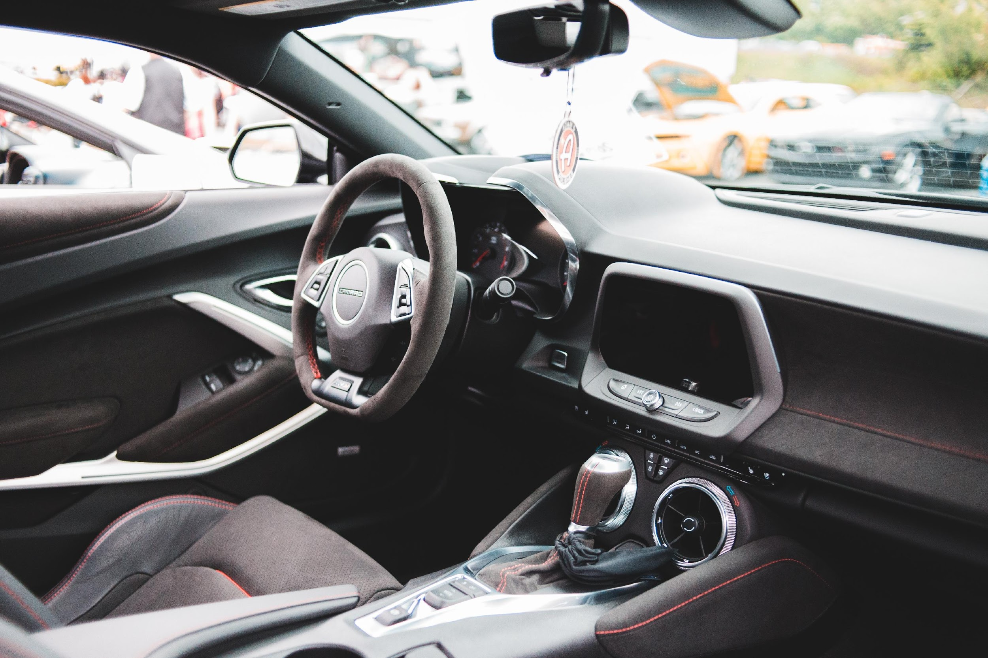

Slide 22


Slide 23


INTERFACES
Connects two or more separate things to exchange information
Complexity behind the interface surface is not visible
There are hardware and software interfaces
Hardware and peripheral devices
Software

Slide 24
GRAPHICAL
USER INTERFACE

Slide 25
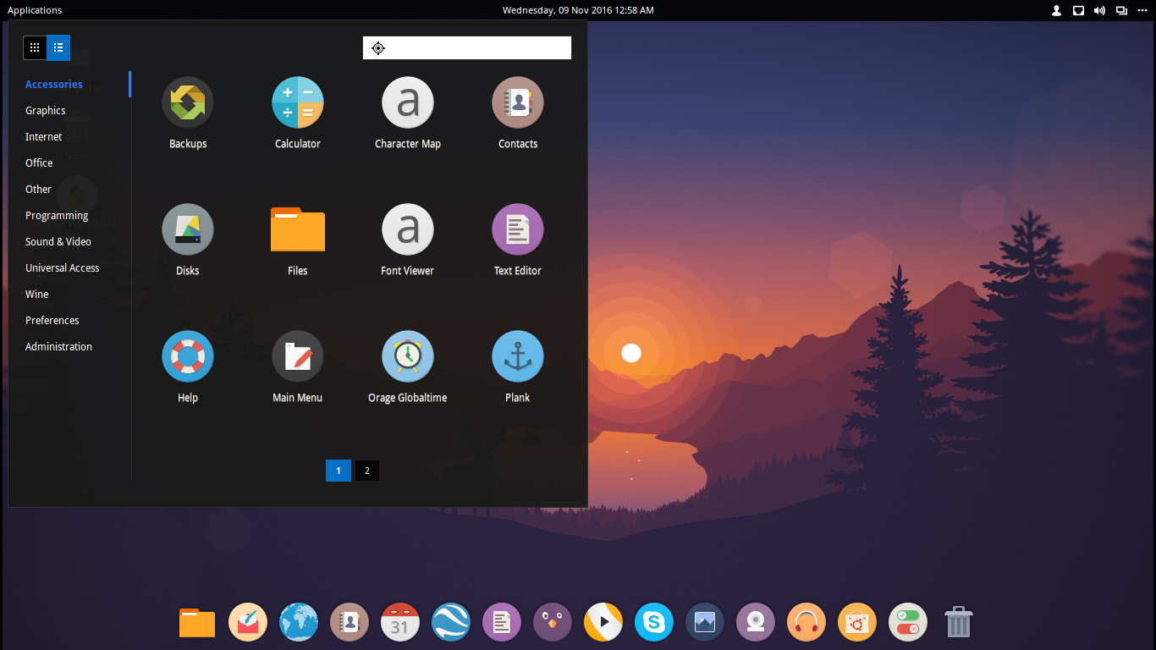
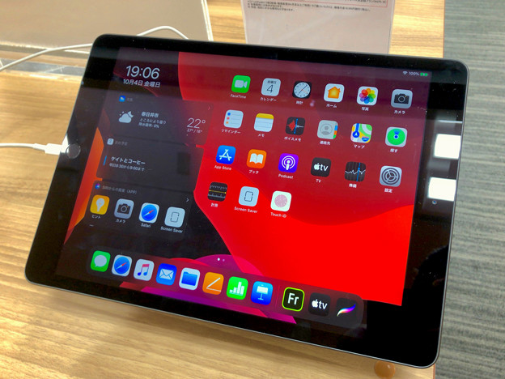
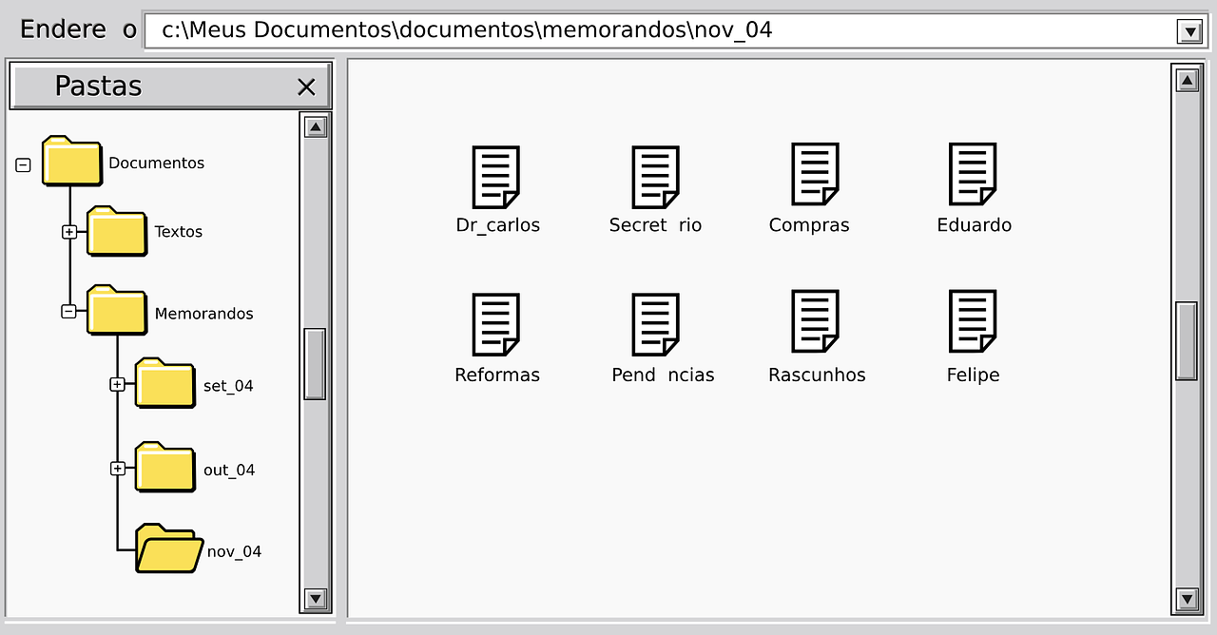
Icons and graphical windows provided as an interface to the OS
Easy to use
Limits the user to what the GUI is capable of

Slide 26
COMMAND LINE
INTERFACE

Slide 27
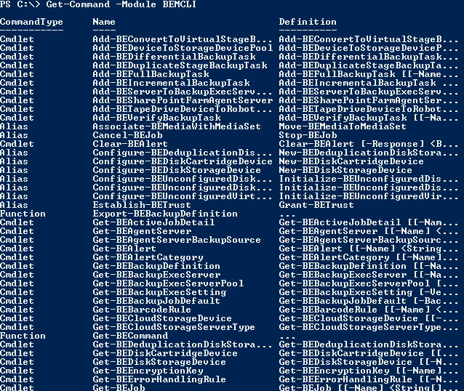
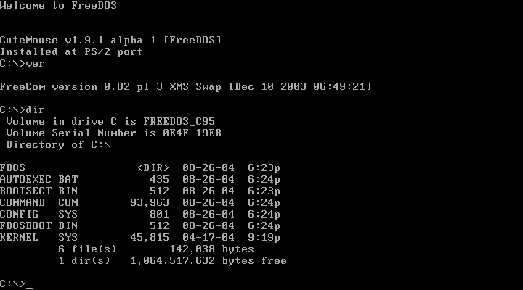
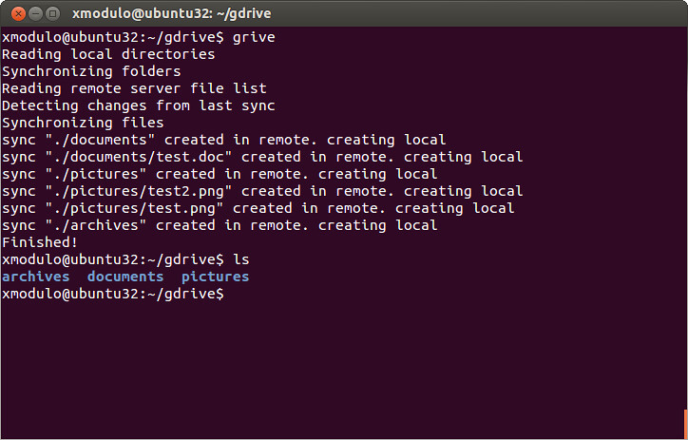
Text-based terminal provided as an interface to the OS
More difficult to use than GUIs
Gives access to the whole system

Slide 28
LINUX FILE SYSTEM HIERARCHY

Slide 29
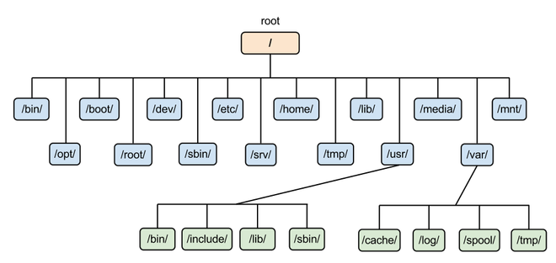
On Windows: Top-level directory is called My Computer
On MacOS and Linux: Top-level directory is called root (/)

Slide 30
LINUX COMMAND LINE BASICS

Slide 31
Setup your WSL
Instructions

Slide 32
Hello World Example
$ echo “hello world”
hello world

Slide 33
Variables
$ TARGET=world
$ echo “hello $TARGET”
hello world

Slide 34
Anatomy of a command
Some commands require additional options
name options arguments
Name of the command
Some commands and options require additional arguments

Slide 35
Example: ls (list files)
Some commands require additional options
ls -ls Documents
name options arguments
Name of the command
Some commands and options require additional arguments

Slide 36
Basic Commands
echo
man
pwd
ls
cd
cat
cp
mv
mkdir
touch
find
grep
sudo
head
tail
ping
wget
uname
top
history
date
whoami

Slide 37
Variables revisited
$ DATE=$(date)
$ echo “today’s date is $DATE”
hello world

Slide 38
Practice
Go to Windows Terminal for Ubuntu and practice some linux commands:
ls, cd,rm,etc.

Slide 39
JOB OPPORTUNITIES

Slide 40


Slide 41


Slide 42


Slide 43
Q&A

Slide 44
THANK YOU!

